Slide 1
Supervised Binary Classifier For IoT Data Stream
Submitted To:
Prof. Tristan Glatard
Submitted By:
MARIA Ratcheva 29709568
MD MANIK HOSSaIN 40108891

Slide 2
Presentation Outline
1. Introduction – Goal of the project
2. Dataset Description
3. Data Analysis
4. Results and Discussion
5. Conclusions
Acknowledgments

Slide 3

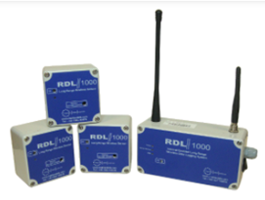
1. Introduction
Context – IoT sensors collect various telemetry data used in smart autonomous buildings.
Goal – Process the stream and build a binary classifier able to accurately predict the target label. The target label is “light”. Our goal is to fit a model that can predict if the light is on or off.
Applications – In emergency situations when the light sensor might not be reliable, for anomaly detection, for remote control.

Slide 4
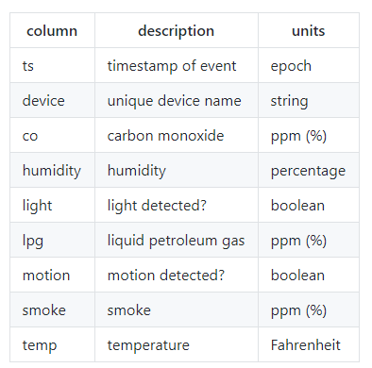
2.Dataset Description
Volume - 405,184 data points
Velocity - Data spans a period of 8 days. The average rate is 1 entry every 1.33 seconds
Variety - Data gathered from three arrays of IoT sensors located in different conditions
Veracity – Data is accurate, no missing data, only few duplicates
Value – Data is useful for monitoring and control of indoor environment
Target class – “light”

Slide 5
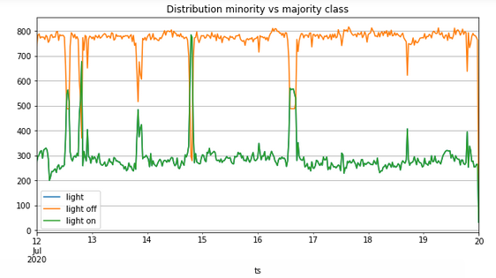
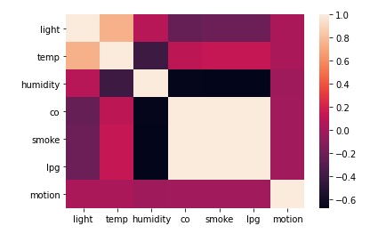
3. Data Analysis
Class | Label | Proportion
Light ON | 1 | 28%
Light OFF | 0 | 72%
Non-stationary: the distribution changes over time
Majority class : Light OFF
Correlation Matrix

Slide 6
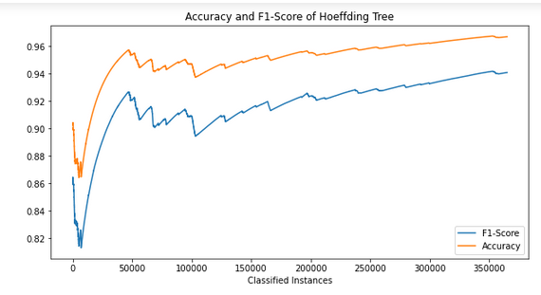
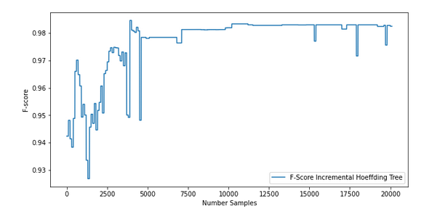
4. Results and Discussion
Hoeffding Tree
Prequential error / Reservoir Sampling
Holdout of a test set / Class weights

Slide 7
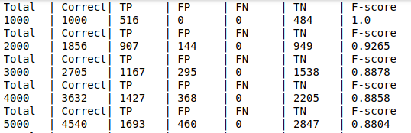
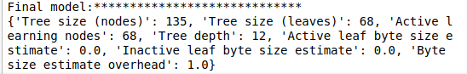
4. Results and Discussion (cont…)
Hoeffding Tree
Confusion matrix
Final Decison Tree

Slide 8
4. Results and Discussion (cont…)
Gaussian Naïve Bayes score and Confusion matrix

Slide 9
4. Results and Discussion (cont…)
Naïve Bayes 4 classifier comparison

Slide 10
Conclusion
1. In case of data stream we apply techniques that are different from the methods used to analyze regular stationary tabular data. Stream data can continuously evolve over time. Reservoir Sampling was used to sample data for training.
2. With Hoeffding Tree we do not need the entire data set to build the decision tree. We can build it incrementally as data points arrive. The Hoeffding Tree has short training time. We obtained high F1-score of 94%.
3. From all the four classifiers of Naïve Bayes, Gaussian Naïve Bayes gives us highest 98% accuracy from both balanced and imbalanced datasets.
4. Evaluation of the obtained models was a challenge. We applied the following methods: Holdout of an independent test set and Prequential Error.

Slide 11
Acknowledgments
This project would not be possible without the advices of
Prof. Glatard and Martin Khannouz
THANK YOU

